Slide 1
HNDIT1032 Computer and Network Systems
Week 07- Registers & Instructions

Slide 2
Von Neumann Model
Von-Neumann proposed his computer architecture design in 1945 which was later known as Von-Neumann Architecture.
It consisted of a Control Unit, Arithmetic, and Logical Memory Unit (ALU), Registers and Inputs/Outputs.

Slide 3
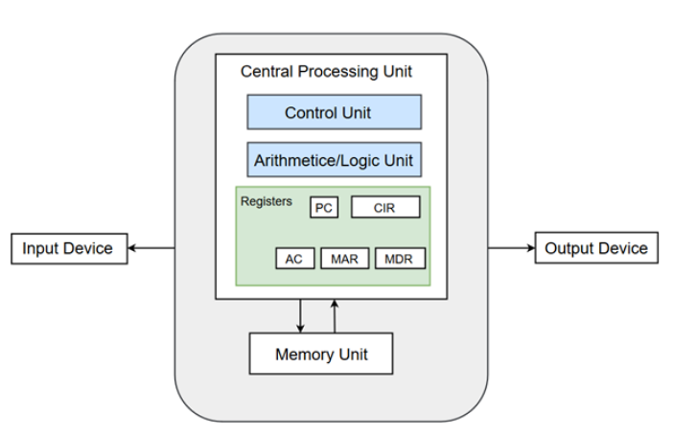
Von Neumann Model

Slide 4
Components of CPU
ALU
Control Unit
Registers

Slide 5
Registers
Registers are high-speed storage areas within the CPU, but have the least storage
capacity.
Registers store data, instructions, addresses and intermediate results of processing.
Registers are often referred to as the CPU’s working memory.

Slide 6
Registers
The data and instructions that require processing must be brought in the registers of CPU before they can be processed.
For example, if two numbers are to be added, both numbers are brought in the registers, added and the result is also placed in a register.
Registers are used for different purposes, with each register serving a specific purpose.

Slide 7
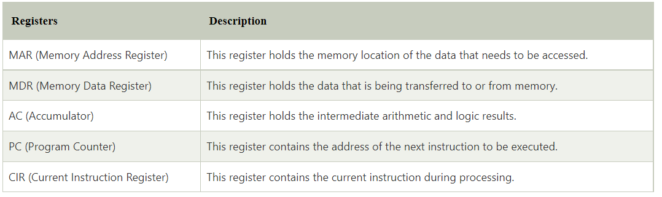
Registers inside the CPU

Slide 8
Size of the Registers
The size of register, also called word size, indicates the amount of data with which the computer can work at any given time.
The bigger the size, the more quickly it can process data.
The size of a register may be 8, 16, 32 or 64 bits.
For example, a 32–bit CPU is one in which each register is 32 bits wide and its CPU can manipulate 32 bits of data at a time.
Nowadays, PCs have 32–bit or 64–bit registers.

Slide 9
Stored Program Concept
The program and the data, on which the program operates, are stored in main memory, waiting to be processed by the processor.
This is also called the stored program
concept.
Instructions are key concept.

Slide 10
What are Instructions?
A computer program is a set of instructions that describe the steps to be performed for carrying out a computational task.
An instruction is designed to perform a task and is an elementary operation that the processor can accomplish.

Slide 11
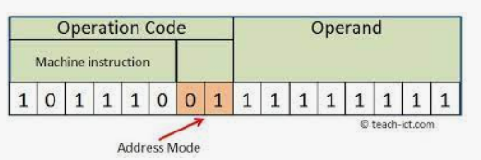
Structure of Instructions
An instruction is divided into groups called fields. The common fields of an instruction are
Operation code
Operand code

Slide 12
Opcode & Operands
The operation code represents action
that the processor must execute.
It tells the processor what basic operations to perform.
The operand code defines the parameters of the action and depends on the operation.

Slide 13
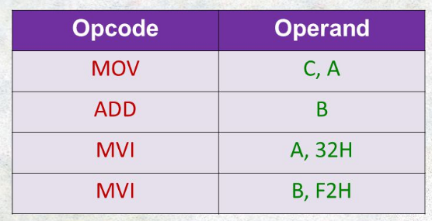
Example

Slide 14
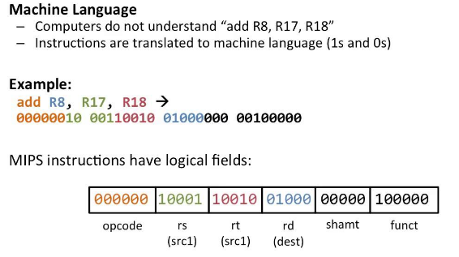
Example of instruction ADD

Slide 15
Instruction Set
A processor has a set of instructions that it understands, called as instruction set.
An instruction set or an instruction set architecture(ISA) is a part of the computer architecture.
It relates to programming, instructions, registers, addressing modes, memory architecture, etc.

Slide 16
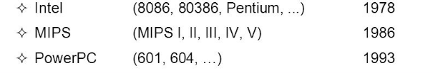
Examples ISA

Slide 17
Microarchitecture
Microarchitecture is the processor design technique used for implementing the Instruction Set.
Computers having different microarchitecture can have a common Instruction Set.
Pentium and Athlon CPU chips implement the x86 instruction set, but have different internal designs.

Slide 18
CISC vs RISC
On the basis of the instruction set, microprocessors are classified as—Reduced Instruction Set Computer (RISC)
Complex Instruction Set Computer (CISC)-the x86 instruction set of the original Intel 8086
processor is of the CISC type. The PCs are based on the x86 instruction set.

Slide 19
CISC
CISC has a large instruction set .
Instructions are of variable lengths, using 8, 16 or 32 bits for storage.
Need more transistors.
AMD and Cyrix are based on CISC.

Slide 20
RISC
RISC has simple, single-cycle instructions, which performs only basic instructions.
RISC has fewer instructions and requires fewer transistors.
The instruction size is fixed (32 bits).
RISC processors can handle multiple instructions simultaneously.
Apple Mac G3 and PowerPC are based on RISC.

Slide 21
Next week
Instruction fetch/execute life cycle

Slide 22
References
Clements, A., The Principles of Computer Hardware, Oxford University Press (4th Ed), 2006.

